Slide 1
Digital System
Chapter VII.
Memory and Programmable Logic
고려대학교
전기전자전파공학부
최 린

Slide 2




Memory Types
Volatile vs Non-volatile
  Non-volatile memory
    A memory that can retain its state without power
    ROM, PROM, EPROM, EEPROM, FLASH
      read-only or write time much greater than read time
    DISK, TAPE
  Volatile memory
    A memory that cannot retain its state without power
    SRAM, DRAM
Random-access vs serial access
  Random access
    Access time is independent on the location of data
    RAM, ROM, FLASH
  Serial access memory
    Access time is dependent on the location of data
    DISK, TAPE

Slide 3
Memory
Programmable Logic Device (PLD)
  Programming
    A hardware procedure that specifies the bits to obtain a particular configuration of the desired logic function.
    Initially all the fuses are intact. Programming the device involves blowing those fuses
  Types of programmable logic devices
    ROM is an example of a PLD
    PLA (Programmable Logic Array)
    PAL(Programmable Array Logic)
    FPGA (Field Programmable Gate Array)

Slide 4
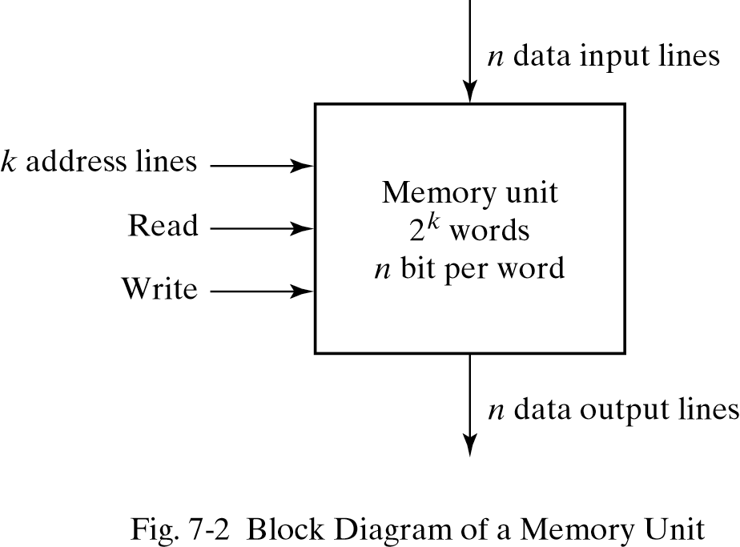


Random-Access Memory (RAM)
RAM
  Random access implies that the time to access any memory location is the same regardless of the location
  RAM actually refers to read-writable random access memory
Configuration

Slide 5
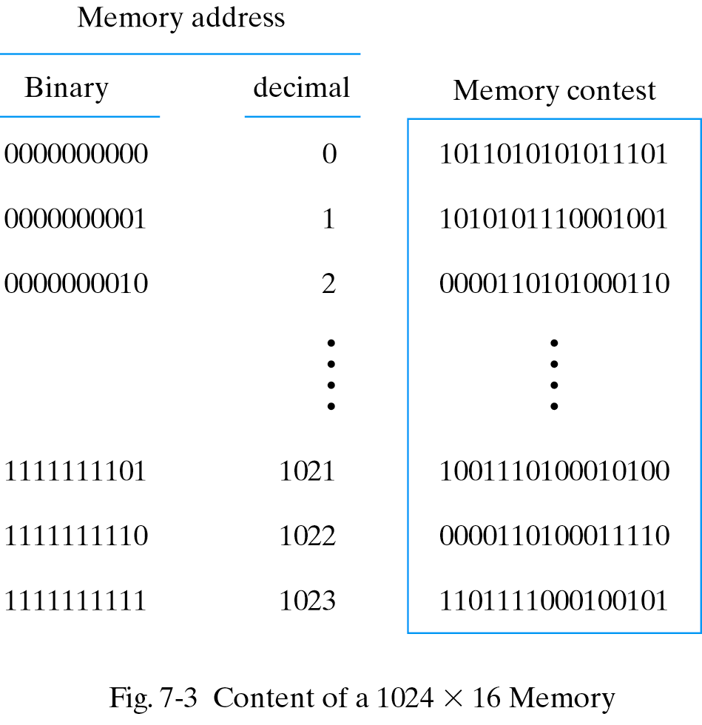
RAM Example
A memory unit with 1K words of 16 bits each
  1024 x 2 bytes = 2K bytes
  Address: 10 bits; data: 16 bits

Slide 6
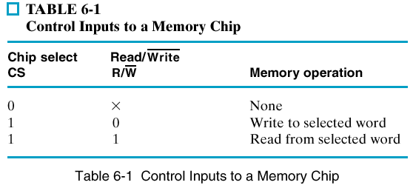

RAM Read & Write Operations
Steps of write operation
    1) Apply the binary address to the address lines
    2) Apply the data bits to the data input lines
    3) Activate the Write input
Steps of read operation
    1) Apply the binary address to the address lines
    2) Activate the Read input
Control lines
    Read & write
    Chip select
    Read/write

Slide 7
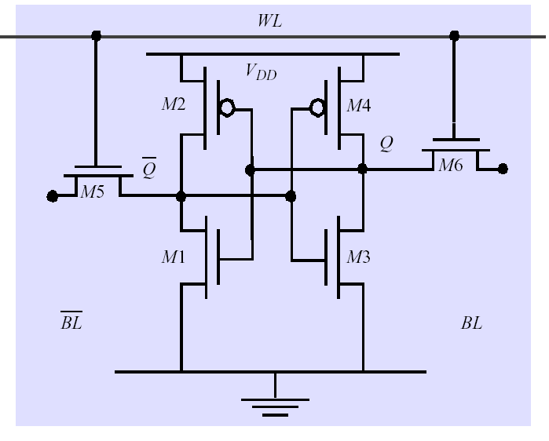
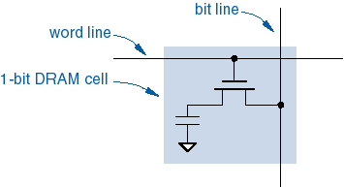
Static vs. Dynamic RAM
Static vs. Dynamic Memory
  Static RAM (6 or more transistors)
    State can be retained while power is supplied
    Use latched storage
  Dynamic RAM (usually 1 transistor)
    State is discharged as time goes by
    Use dynamic storage of charge on a capacitor
    Require refresh of each cell every few milliseconds
    Slower but require less transistors
    Multiplexed address lines - RAS, CAS
    Complex interface logic due to refresh and precharge

Slide 8
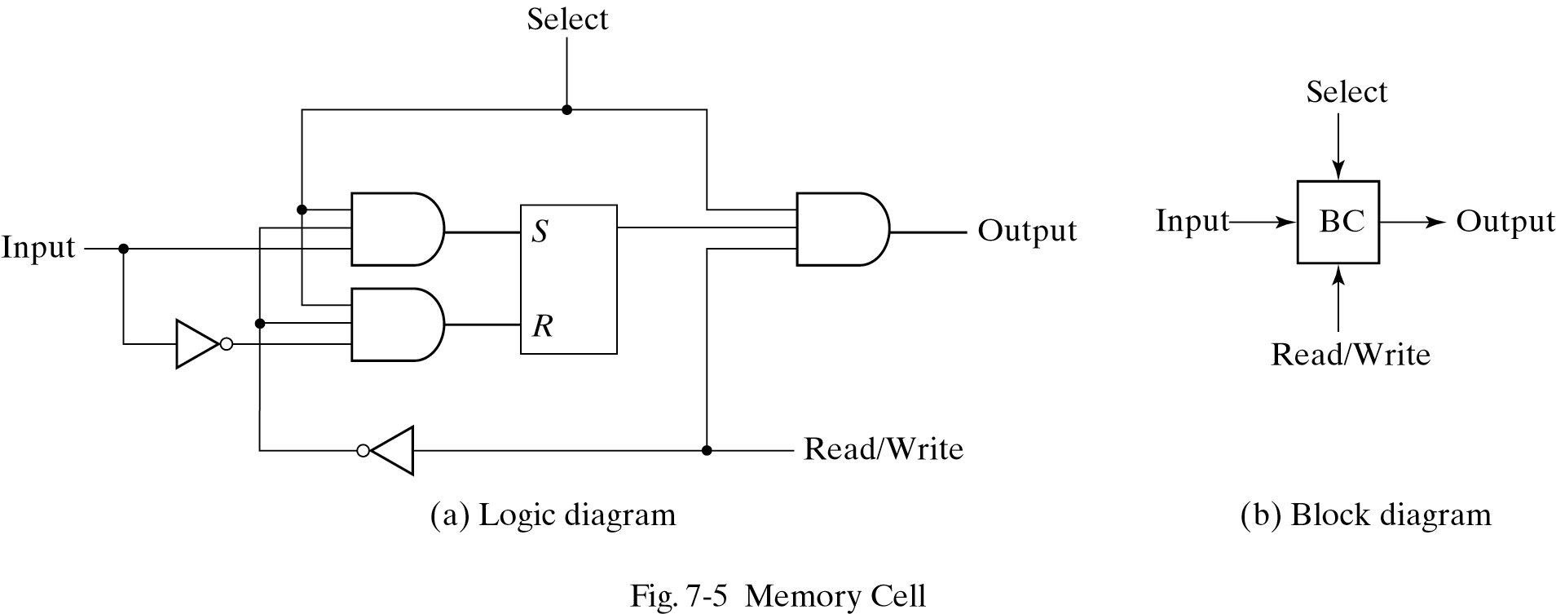
A Static RAM Cell
Internal structure
  A RAM chip of m words & n bits per word consists of
    m x n binary storage cells
    Decoders to select the word to be read or written
Logical view of a static RAM cell
  The cell is implemented with 6 transistors and modeled by an SR latch.
  Select input enables the cell for reading or writing.
  If the read/write input = 0, write is performed. Otherwise, read is performed.

Slide 9
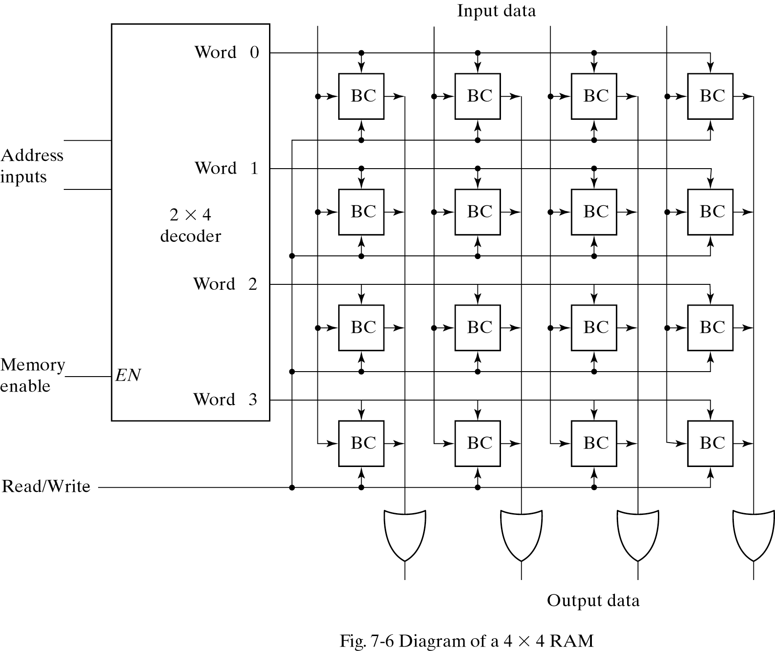
4 X 4 RAM
  A memory with 2^{K} words of n bits per word require k address lines that go into a k X 2^{K} decoder.

Slide 10
Row and Column Decoding
Two-Dimensional Decoding
  A decoder with k inputs & 2^{k} outputs requires 2^{k} AND gates with k inputs per gate
  Employ 2 decoders to reduce the total number of gates
    Use two k/2-input decoders
  Example: 10 x 1024 decoder versus two 5 x 32 decoders
    1024 10-input AND gates versus 64 5-input AND gates
    Reduced hardware and parallel decoding permits faster access time
  Two-dimensional decoding
    One controls the word select lines (Row select)
    The other controls the bit select lines (Column select)

Slide 11
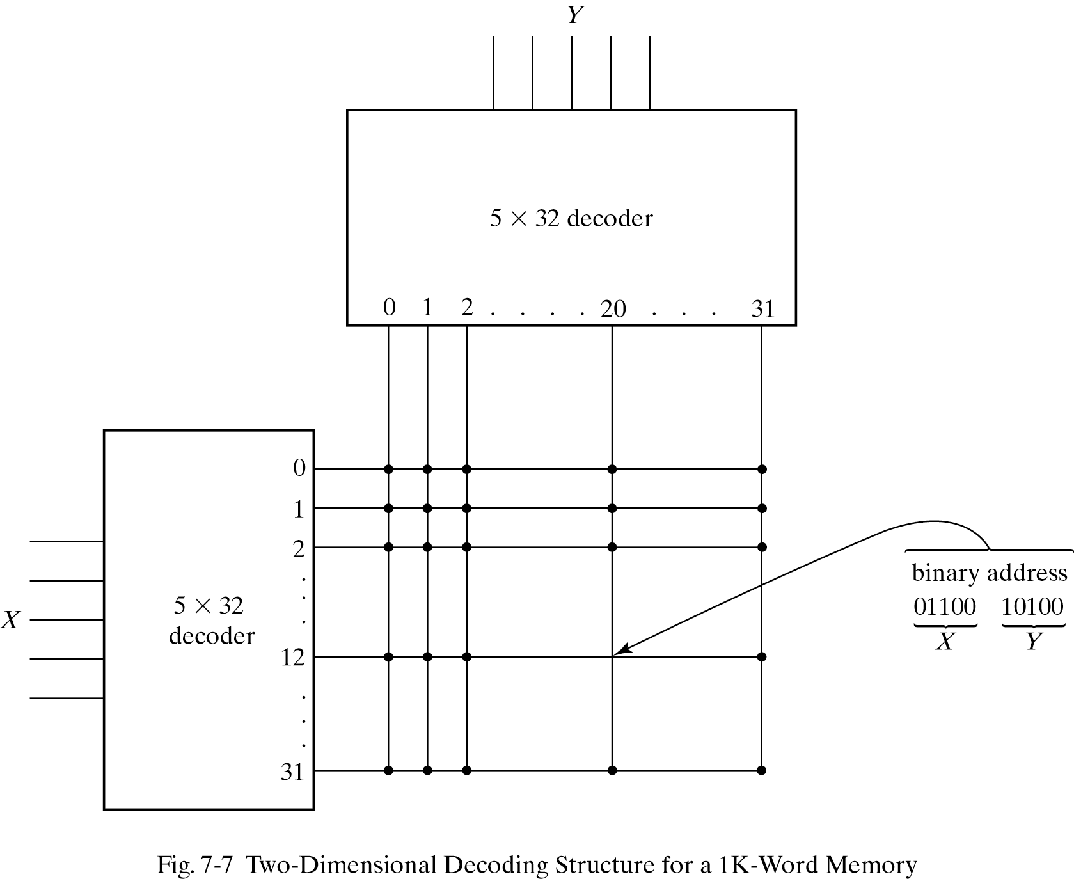
Two-Dimensional Decoding
  For address 404 (x01100 10100), X = 01100, Y = 10100

Slide 12
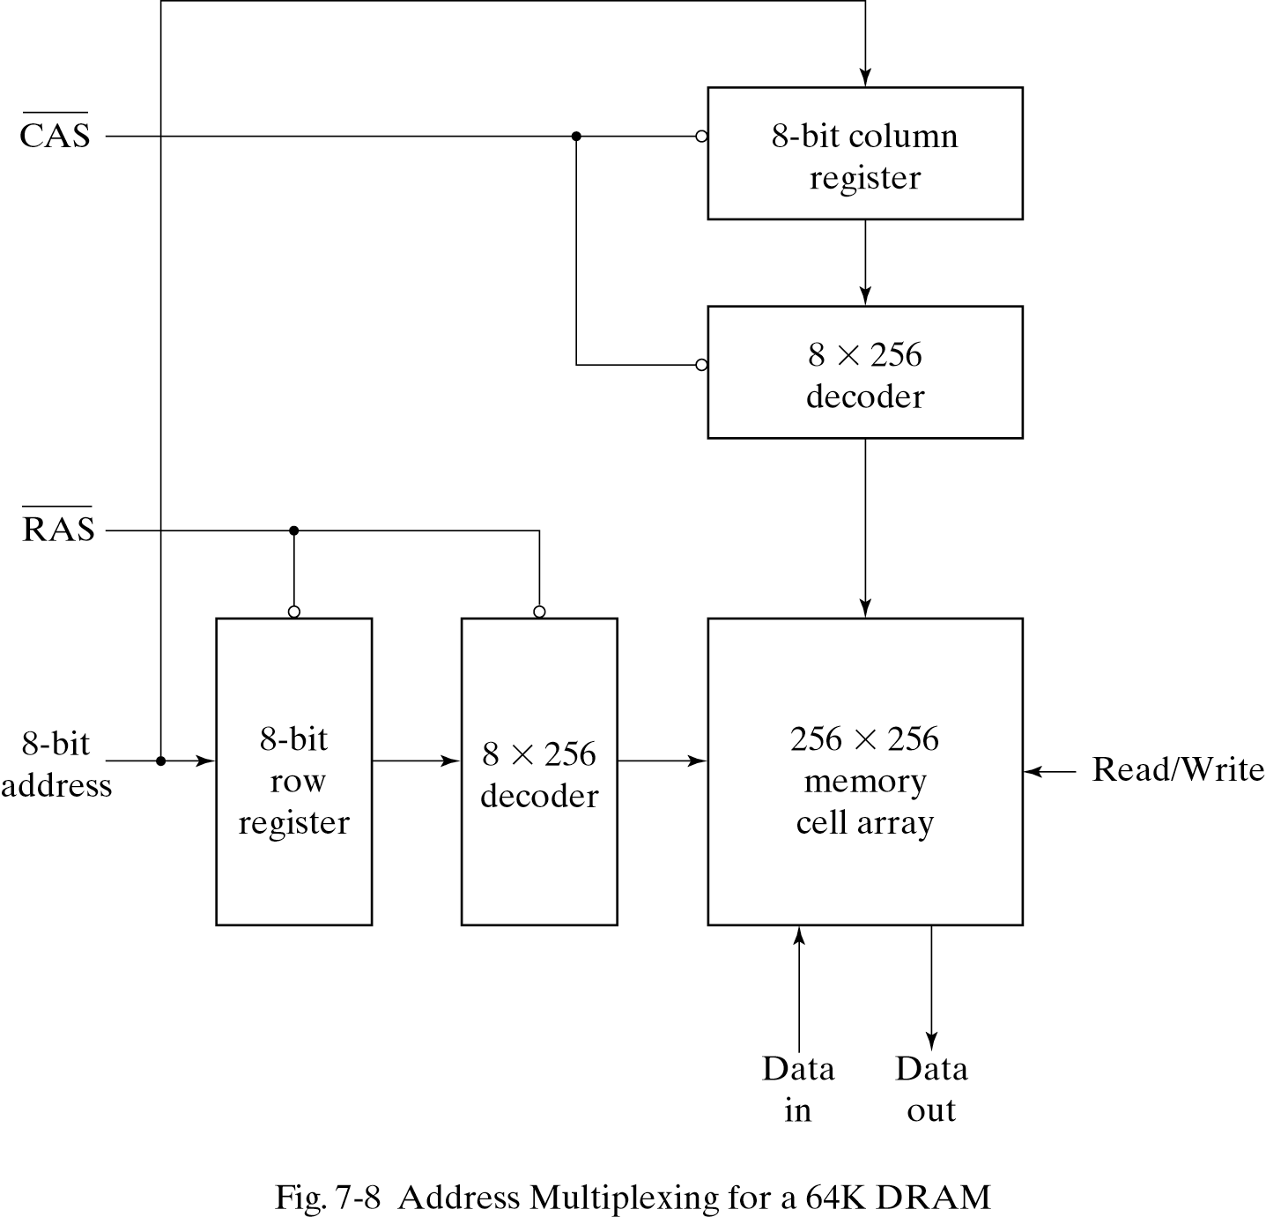
Address Multiplexing
DRAM uses the two-dimensional decoding
  Can reduce the size of the decoders
  Can reduce the number of pins in the IC package
64K-word DRAM memory
  Initially both RAS and CAS strobes are in the 1 state.
  The 8-bit row address is applied first, and then 8-bit column address is presented

Slide 13
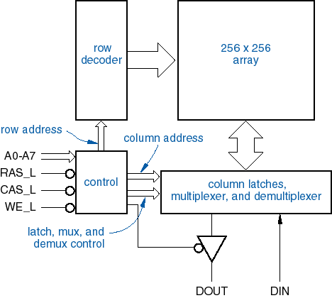
DRAM Chip Internal Organization
64K x 1 bit DRAM
Row Address Strobe, Column Address Strobe
  n address bits are provided in two steps using n/2 pins, referenced to the falling edges of RAS_L and CAS_L
  Traditional method of DRAM operation for 20 years.

Slide 14
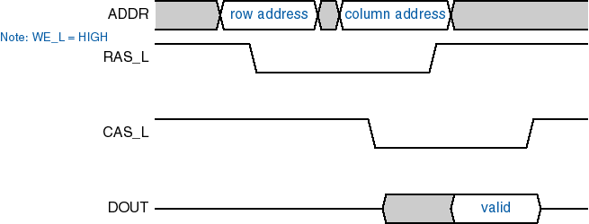
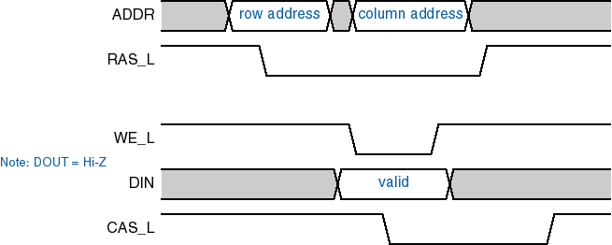

DRAM Timing Diagram
DRAM read timing
DRAM write timing

Slide 15
Hamming Code
Error detection
  Parity bit is used to detect single-bit errors
Error correcting codes
  Use multiple parity check bits
    Each check bit is a parity over a group of bits in the data word
  If the check bits are not correct, they generate a unique pattern, called syndrome, that can be used to identify the bit in error
Hamming code
  k parity bits are added to an n-bit data word to form n+k bits
  The bit positions are numbered in sequence from 1 to n + k
  Positions at a power of 2 (1, 2, 4, 8, 16, …)are reserved for the parity bits.
  The remaining bits are the data bits.

Slide 16
Hamming Code
Example: 8-bit data word:11000100
  Bit position 1 2 3 4 5 6 7 8 9 10 11 12
    P1 P2 1 P4 1 0 0 P8 0 1 0 0
  P1=XOR of bits(3,5,7,9,11)=0 (XOR performs the odd function.)
  P2=XOR of bits(3,6,7,10,11)=0
  P4=XOR of bits(5,6,7,12)=1
  P8=XOR of bits(9,10,11,12)=1
  In memory, Bit position 1 2 3 4 5 6 7 8 9 10 11 12
    0 0 1 1 1 0 0 1 0 1 0 0
  When the 12 bits are read from memory ,The four check bits
  C1=XOR of bits (1,3,5,7,9,11)
  C2=XOR of bits (2,3,6,7,10,11)
  C4=XOR of bits (4,5,6,7,12)
  C8=XOR of bits (8,9,10,11,12)

Slide 17
Hamming Code
  Since the bits were stored with even parity C=C₈C₄C₂C₁=0000 (No error)
  Bit position 1 2 3 4 5 6 7 8 9 10 11 12
  0 0 1 1 1 0 0 1 0 1 0 0 No error
  1 0 1 1 1 0 0 1 0 1 0 0 Error in bit 1
  0 0 1 1 0 0 0 1 0 1 0 0 Error in bit 5
  Check bits C₈ C₄ C₂ C₁
  With error in bit 1 : 0 0 0 1
  With error in bit 5: 0 1 0 1
  The 4-bit binary number (syndrome) formed by check bits gives the position of the erroneous bit.
  The error can be corrected by complementing the corresponding bit.
In general, the following relationship holds with the Hamming code with k check bits and n data bits
  2^{k} – 1 >= n + k. Therefore, n <= 2^{k} – k – 1
  Ex) when k = 3, n <=4, when k = 4, n <= 11

Slide 18
SECDEC
Single Error Correction, Double Error Detection
  The Hamming code can detect and correct only a single error
  By adding another parity bit to the coded word, the Hamming code can be used to correct a single error and detect double errors
  For the previous 12-bit coded word, SECDEC becomes 001110010100P₁₃
    P₁₃ is evaluated from the XOR of the other 12 bits
  If P = 0, the parity is correct (even parity), but if P = 1, then the parity over the 13 bits are incorrect. The following 4 cases can arise.
    If C = 0 and P = 0, no error
    If C ≠ 0 and P = 1, a single error occurred that can be corrected
    If C ≠ 0 and P = 0, a double error occurred that is detected but cannot be corrected
    If C = 0 and P = 1, an error occurred in P₁₃
  This scheme may detect more than two errors, but it is not guaranteed to detect all such errors.

Slide 19
Programmable Logic Technologies
Programmable Logic Device (PLD)
  Programming
    A hardware procedure that specifies the bits to obtain a particular configuration of the desired logic function.
    In PLDs, programming is used to establish or break interconnections, build lookup tables, and control transistor switching.
Five types of programmable logic devices
    ROM is one example of a PLD
    PLA (Programmable Logic Array)
    PAL(Programmable Array Logic)
    CPLD (Complex Programmable Logic Device)
    FPGA (Field Programmable Gate Array)

Slide 20
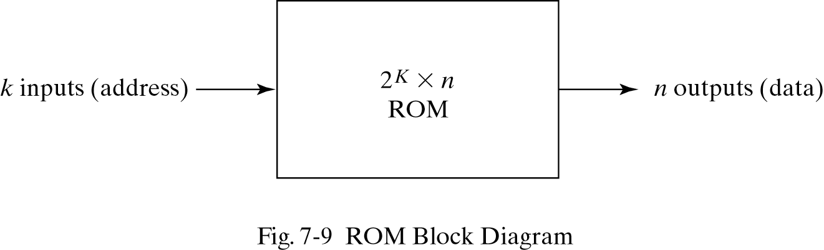
Read-Only Memory
ROM
  A memory device in which a permanent binary information is stored
    Once a pattern is established, it stays even when power is turned off
  Consist of k address inputs and n data outputs

Slide 21
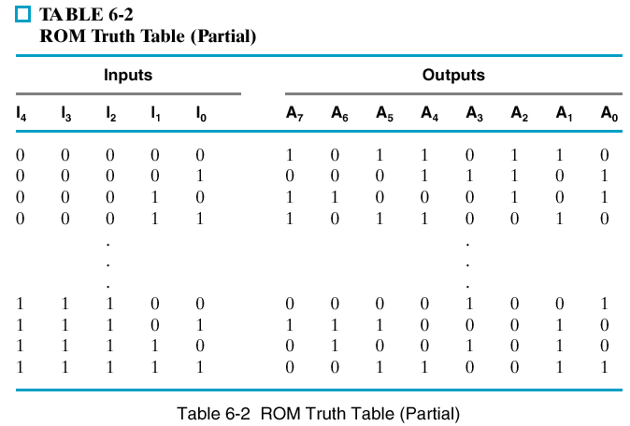
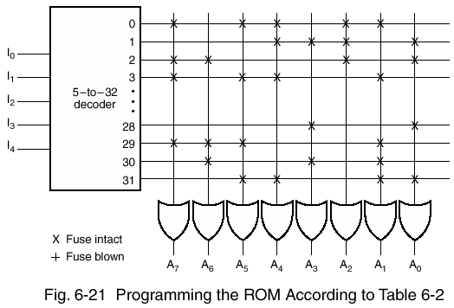
32 x 8 ROM
  The unit consists of 32 words of 8 bits each
  The internal binary storage of a ROM is specified by a truth table
  ROM includes both the decoder (e.g. 5 x 32 decoder) and the OR gates to sum the minterms
  Programming the ROM results in blowing the fuse links according to a given truth table

Slide 22
Read-Only Memory
Combinational Circuit Implementation
  ROM essentially includes both decoder & OR gates
    A decoder generates the 2^{k} minterms of the k input variables
    OR gates to sum the minterms of Boolean functions
  ROM outputs can be programmed to represent any Boolean functions in a combinational circuit
  Widely used to implement complex combinational circuits directly
Types of ROMs
  Mask programming (ROM)
    Done by the semiconductor company during the last fabrication process
    Expensive and only for a large volume
  Fuse (PROM)
    Done by the user by applying a high-voltage to the fuses to blow out connections
  Erasable floating gate technology (EPROM)
    Use a UV light and can be reprogrammed
  Electrically erasable technology (EEPROM)
    Use an electrical signal instead of UV light

Slide 23
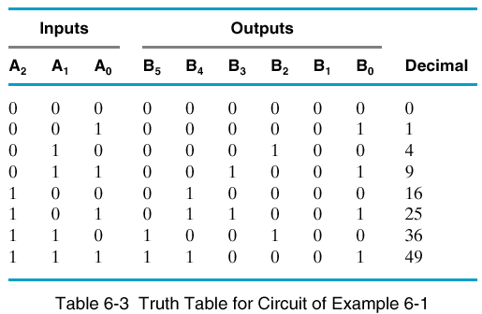
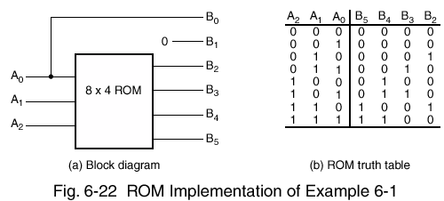
Combinational Circuit Design with ROM
Example
  Accept a 3-bit number and generate an output binary number equal to the square of the input number

Slide 24
Combinational PLD
Programmable Logic Device
  An integrated circuit with an array of gates that are connected by programmable fuses
  The gates in a PLD are divided into AND array & OR array to provide and AND-OR sum of products implementation
PROM
  A fixed AND array constructed as a decoder & programmable connections for the output OR gates
  Implements Boolean functions in sum-of-minterms form
PAL
  A programmable connection AND array & a fixed OR array
  AND gates are programmed to provide the product terms, which are logically summed in each OR gate
PLA
  The most flexible PLD
  Both AND & OR arrays can be programmed
  Product terms in the AND array may be shared by any OR gate to provide the required sum of products implementation

Slide 25
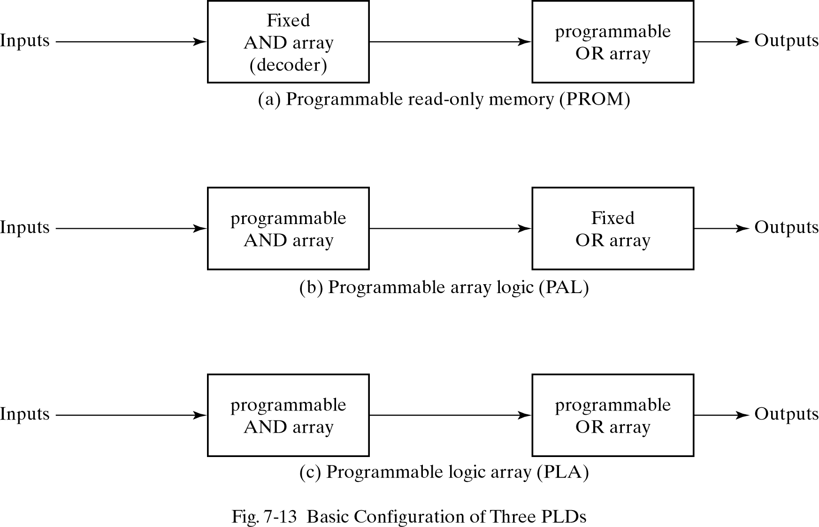
Programmable Logic Device

Slide 26
Programmable Logic Array (PLA)
PLA
  The most flexible PLD
    But the PLA doesn't usually provide full decoding of the variables & doesn't generate all the minterms
  Both AND & OR arrays can be programmed
    Decoder is replaced by an array of AND gates to generate any product term
    The product terms are then connected to OR gates to provide the sum of products
  Product terms in the AND array may be shared by any OR gate to provide the required sum of products implementation
  Internal logic of a PLA
    Each input goes through a buffer and an inverter
    Connected through fuses to the inputs of each AND gate
    Output of AND gates are connected by fuses to OR gate
    Output of OR gates goes to an XOR gate, where the other input can be programmed to receive a signal

Slide 27
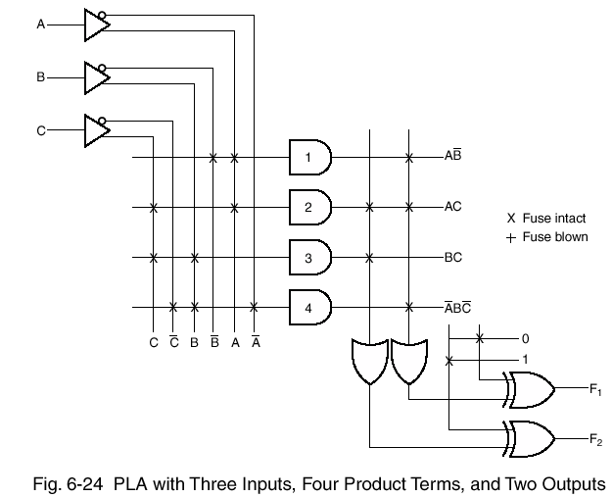
Programmable Logic Array (PLA)
  F₁ = AB' + AC + A'BC'; F₂ = (AC + BC)'

Slide 28
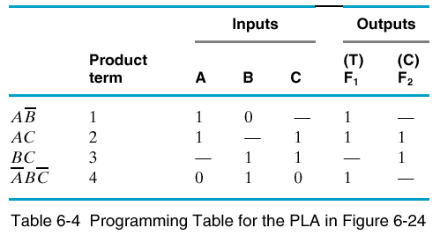
Programmable Logic Array (PLA)
The fuse map of a PLA in a tabular form consists of 3 sections
  List of the product terms
  Paths between inputs & AND gates
  Paths between the AND & OR gates
A careful investigation must be undertaken to reduce the number of distinct product terms
    Obtain both the true & complement of the function
    Select a combination that gives a minimum number of product terms

Slide 29
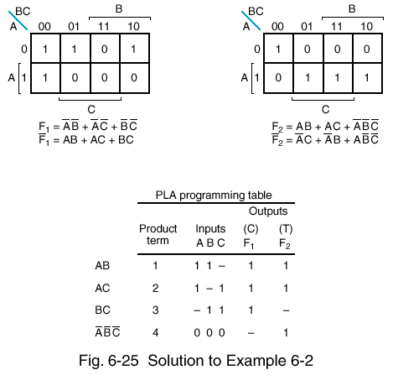
Programmable Logic Array (PLA)
  <Example> Implement the following functions with a PLA
      F₁(A,B,C) = Σ m(0,1,2,4);
      F₂(A,B,C) = Σ m(0,5,6,7)
  1) True & complement of the functions are simplified in sum of products
  2) Select a combination that gives a minimum number of product terms
    F₁ = (AB +AC +BC)';
    F₂ = AB + AC + A'B'C'

Slide 30
Homework VI
PROBLEMS
  7.1
  7.2
  7.7
  7.8
  7.12
  7.17
  7.19
  7.21

